Slide 1
Database Management System (DBMS)

Slide 2
AGENDA
Introduction
What is Database?
What is DBMS?
Glossary Terms in DBMS
Types of Databases
Various DBMS Softwares
Notes:
https://databasetown.com/what-is-dbms-components-features-advantages/

Slide 3
Introduction
A database management system (DBMS) is system software for creating and managing databases.
The name “database management system” consists of two parts.
    Database and
    Management System

Slide 4
What is a Database?
“Collection of related Tables (or Relations)”.
A database is an organized collection of structured information, or data, typically stored electronically in a computer system.
A database is usually controlled by a database management system (DBMS).

Slide 5
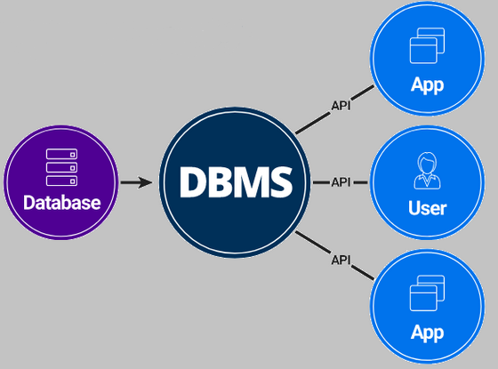
What is DBMS?
“Software to manage databases”.
A Database Management System (DBMS) is a software program that allows users to interact with a database in order to store, retrieve, and manipulate data. The DBMS serves as an interface between the database and the users or application programs.
Also, it enables users to create, modify, and maintain the database, as well as control access to the data.
Notes:
https://www.oracle.com/in/database/what-is-database/
https://databasetown.com/what-is-dbms-components-features-advantages/

Slide 6
Glossary Terms in DBMS
Table or Relation: Collection of related records
Record or Tuple: Collection of related data items. ie., a row in a table. (A structured information)
The columns are called Fields, Attributes or Domains.

Slide 7
Types of Data Models / Designs – (familiar)
Relational Model (Tabular Model)
Flat Data Model
Entity-Relationship Model
Network Model
Hierarchical Model
Object-oriented Data Model
Object Relation Model
Record Based Model
Semi-structured Model
Associative Model
Context Data Model
Notes:
https://databasetown.com/data-models-in-dbms-with-examples/
https://www.oracle.com/in/database/what-is-database/
The ER model for conceptual modeling and the relational model for physical implementation within a DBMS.

Slide 8
Types of Data Bases – (familiar)
Relational Database
Object-Oriented Database
Hierarchical Database
Network Database
Key-Value Database
Document Database
Columnar Database
Graph Database
Time-Series Database
Spatial Database
NoSQL databases
Distributed databases
Notes:
https://www.oracle.com/in/database/what-is-database/

Slide 9
Famous DBMS
Oracle Database : RDBMS
MySQL : RDBMS, mainly for Web Applications
Microsoft SQL Server: RDMS
PostgreSQL : object-relational DBMS
MongoDB : document-oriented NoSQL
Cassandra : distributed & NoSQL
Redis : key-value
SQLite : RDBMS
Amazon Aurora : RDBMS
Elasticsearch : Document-oriented NoSQL (search engine)
Notes:
SQLite: SQLite is a lightweight, file-based relational database management system that doesn't require a separate server process. It is widely used in embedded systems, mobile applications, and small-scale projects.
Amazon Aurora: Amazon Aurora is a relational database service provided by Amazon Web Services (AWS). It is compatible with MySQL and PostgreSQL and is designed for high performance, scalability, and reliability in the cloud.
Elasticsearch: Elasticsearch is a distributed search and analytics engine that is often used for full-text search, log analysis, and data analysis. It provides near real-time data indexing and querying capabilities.

